Slide 1
Data Communications &
Networking
ERROR DETECTION AND CORRECTION
Chapter 8
First Semester 2007/2008

Slide 2
ERROR DETECTION AND CORRECTION
Types of Errors
Detection
Correction

Slide 3


Note:
Data can be corrupted during transmission. For reliable communication, errors must be detected and corrected.

Slide 4
Types of Error
Single-Bit Error
Burst Error

Slide 5
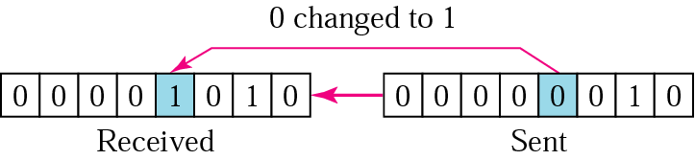
Single-Bit Error
Note:
In a single-bit error, only one bit in the data unit has changed.

Slide 6
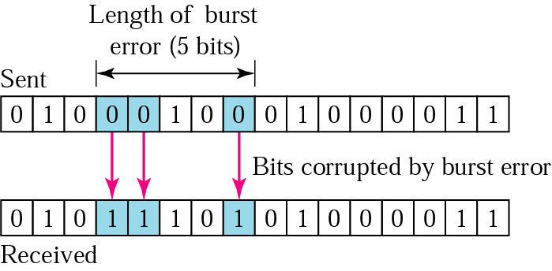
Burst Error
Note:
A burst error means that 2 or more bits in the data unit have changed.

Slide 7
Error Detection
Redundancy
Parity Check
Cyclic Redundancy Check (CRC)
Checksum

Slide 8
Note:
Error detection uses the concept of redundancy, which means adding extra bits for detecting errors at the destination.

Slide 9
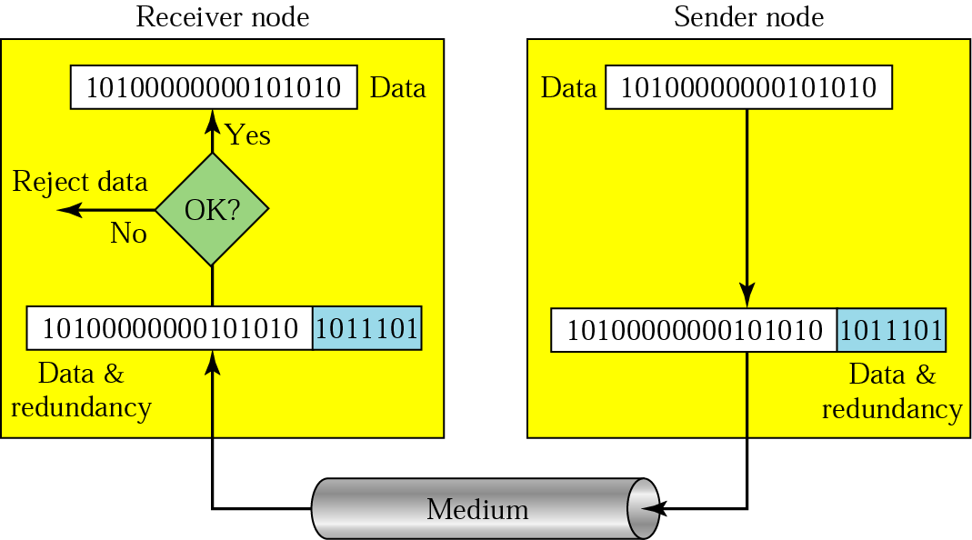
Redundancy

Slide 10
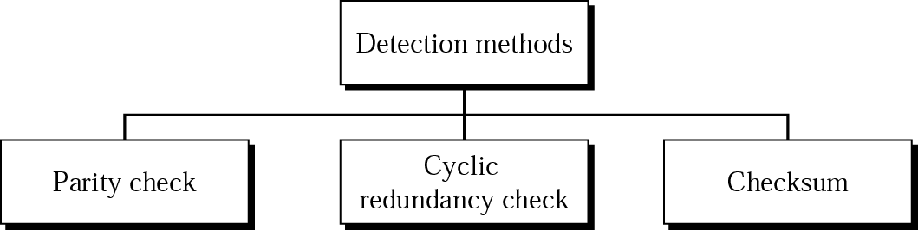
Error Detection methods

Slide 11
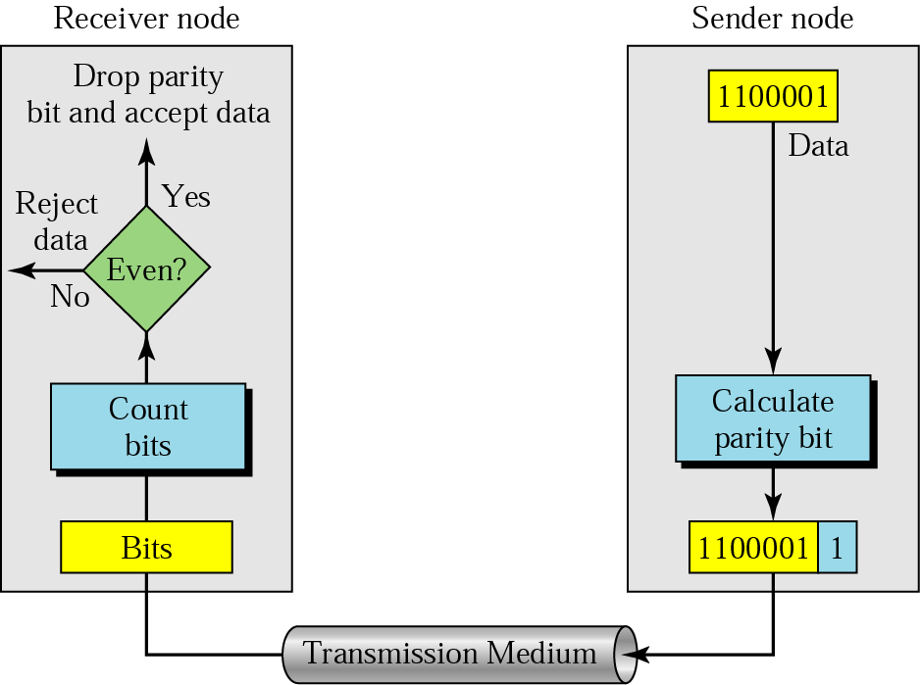
Even-parity concept

Slide 12
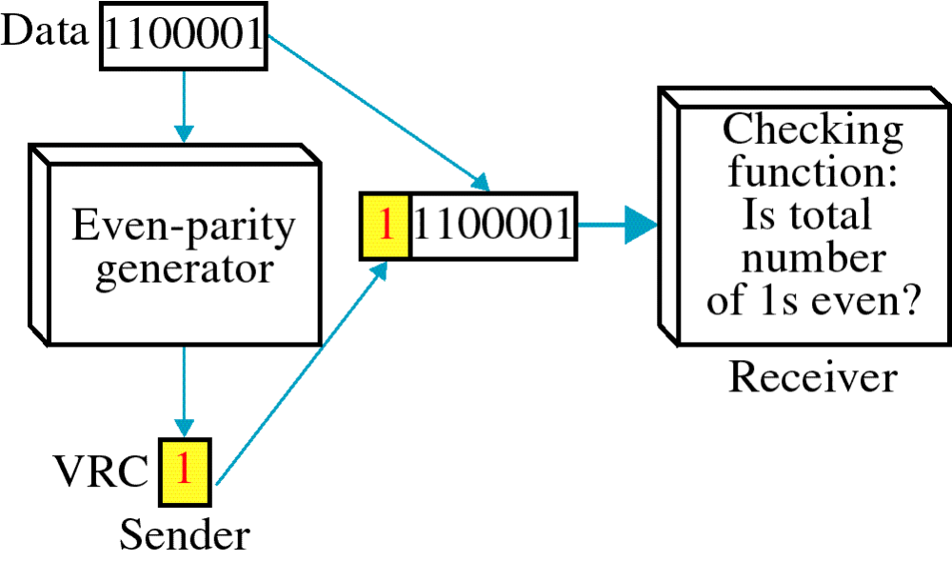
VERTICAL REDUNDANCY CHECK (VRC)

Slide 13
Note:
In parity check, a parity bit is added to every data unit so that the total number of 1s is even
(or odd for odd-parity).

Slide 14
Example 1
Suppose the sender wants to send the word world. In ASCII the five characters are coded as
1110111 1101111 1110010 1101100 1100100
The following shows the actual bits sent
11101110 11011110 11100100 11011000 11001001

Slide 15
Example 2
Now suppose the word world in Example 1 is received by the receiver without being corrupted in transmission.
11101110 11011110 11100100 11011000 11001001
The receiver counts the 1s in each character and comes up with even numbers (6, 6, 4, 4, 3). The data are accepted.

Slide 16
Example 3
Now suppose the word world in Example 1 is corrupted during transmission.
11111110 11011110 11101100 11011000 11001001
The receiver counts the 1s in each character and comes up with even and odd numbers (7, 6, 5, 4, 4). The receiver knows that the data are corrupted, discards them, and asks for retransmission.

Slide 17
Note:
Simple parity check can detect all single-bit errors. It can detect burst errors only if the total number of errors in each data unit is odd.

Slide 18
LONGITUDINAL REDUNDANCY CHECK
LRC
11100111 11011101 00111001 10101001
10101001
00111001
11011101
11100111
LRC 10101010
11100111 11011101 00111001 10101001 10101010
Data plus LRC

Slide 19
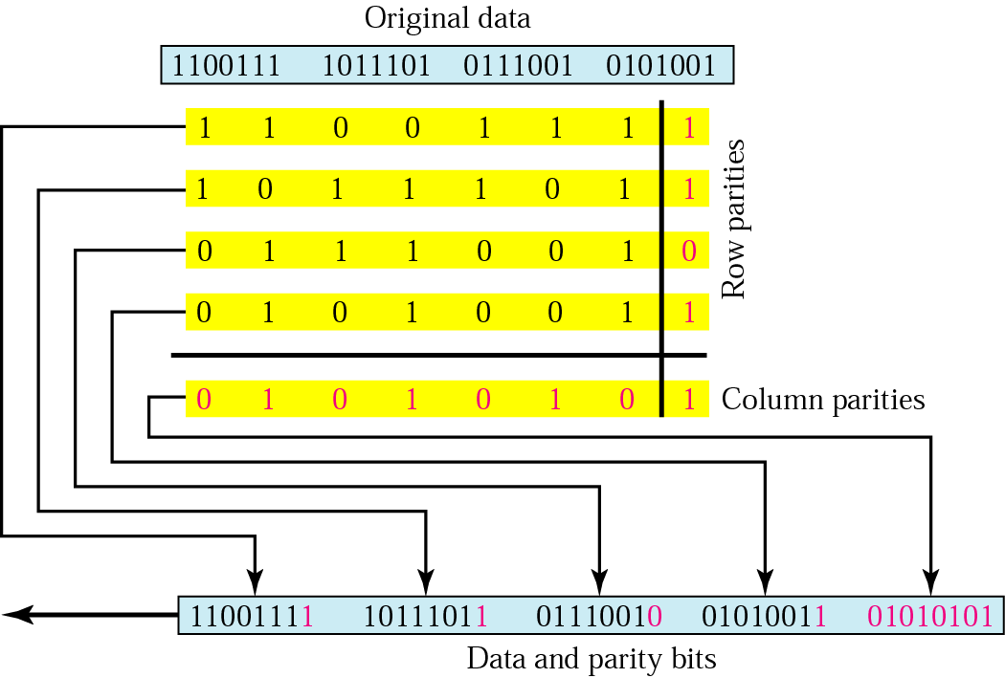
Two-dimensional parity

Slide 20
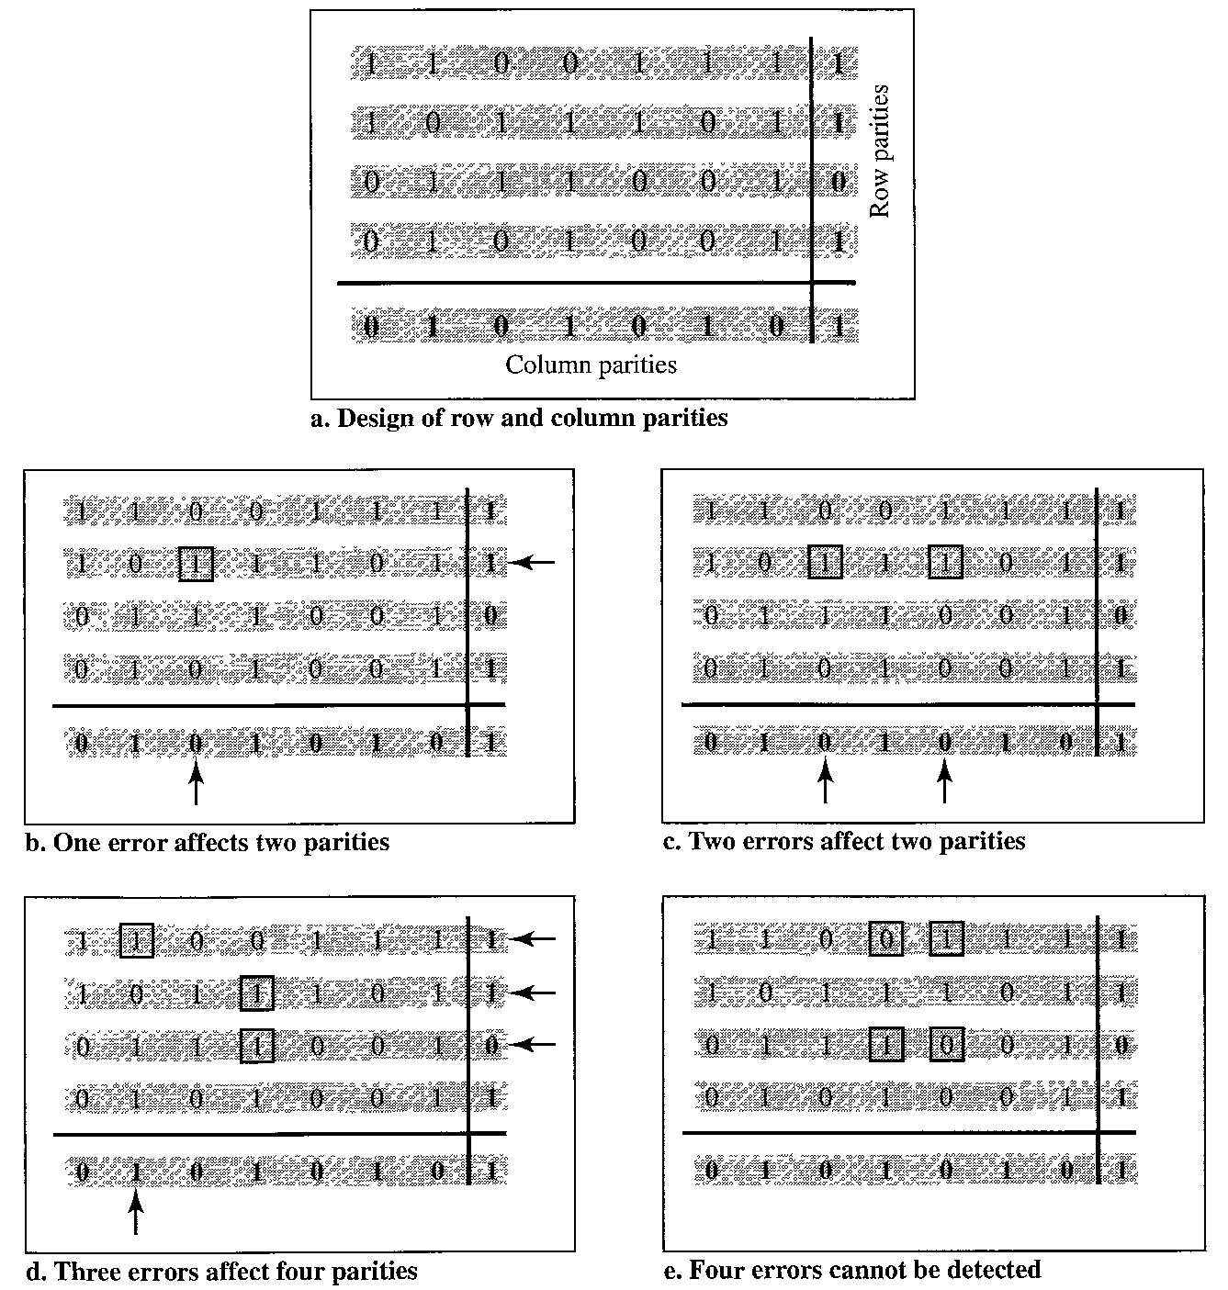
Figure 10.11 Two-dimensional parity-check code

Slide 21
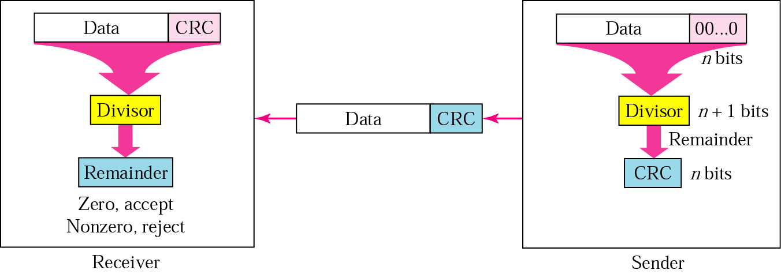
CRC generator and checker

Slide 22
Data unit and checksum
Receiver
Sender
T
-T

Slide 23
Note:
The sender follows these steps:
The unit is divided into k sections, each of n bits.
All sections are added using one’s complement to get the sum.
The sum is complemented and becomes the checksum.
The checksum is sent with the data.

Slide 24
Note:
The receiver follows these steps:
The unit is divided into k sections, each of n bits.
All sections are added using one’s complement to get the sum.
The sum is complemented.
If the result is zero, the data are accepted: otherwise, rejected.

Slide 25
Example 4
Suppose the following block of 16 bits is to be sent using a checksum of 8 bits.
10101001 00111001
The numbers are added using one’s complement
10101001
00111001
------------
Sum 11100010
Checksum 00011101
The pattern sent is 10101001 00111001 00011101

Slide 26
Example 5
Now suppose the receiver receives the pattern sent in Example 7 and there is no error.
10101001 00111001 00011101
When the receiver adds the three sections, it will get all 1s, which, after complementing, is all 0s and shows that there is no error.
10101001
00111001
00011101
Sum 11111111
Complement 00000000 means that the pattern is OK.

Slide 27
Example 6
Now suppose there is a burst error of length 5 that affects 4 bits.
10101111 11111001 00011101
When the receiver adds the three sections, it gets
10101111
11111001
00011101
Partial Sum 1 11000101
Carry 1
Sum 11000110
Complement 00111001 the pattern is corrupted.

Slide 28
Correction
Retransmission
Forward Error Correction
Burst Error Correction

Slide 29
Hamming Code

Slide 30
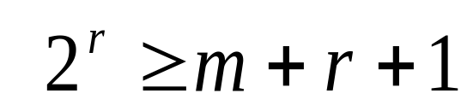
Data and redundancy bits
Number of data bits m | Number of redundancy bits r | Total bits m + r
1 | 2 | 3
2 | 3 | 5
3 | 3 | 6
4 | 3 | 7
5 | 4 | 9
6 | 4 | 10
7 | 4 | 11

Slide 31
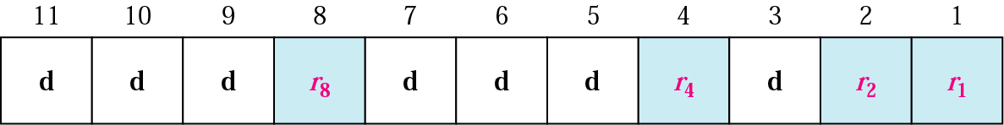
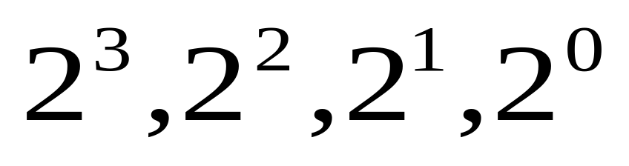
Positions of redundancy bits in Hamming code

Slide 32
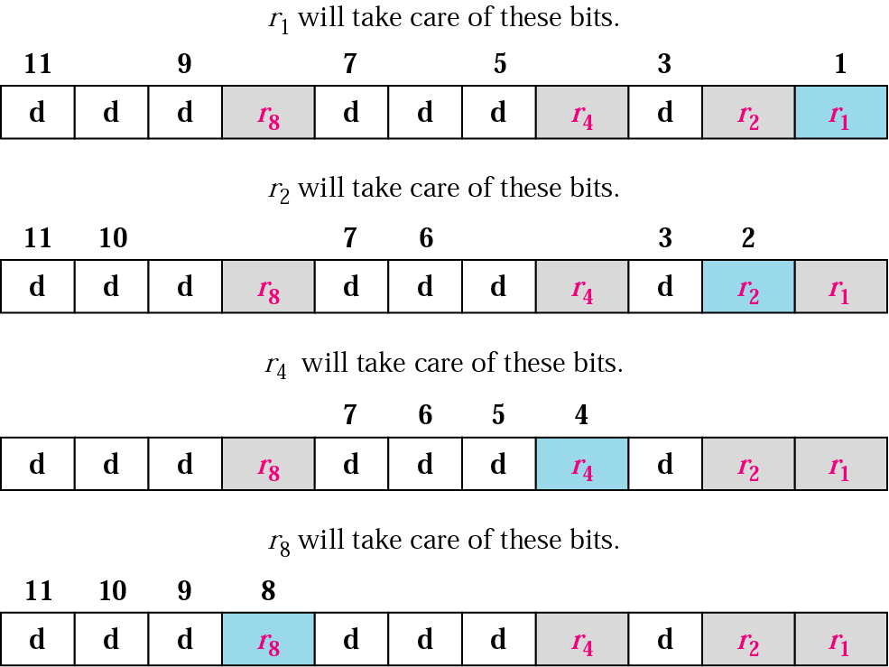
Redundancy bits calculation

Slide 33
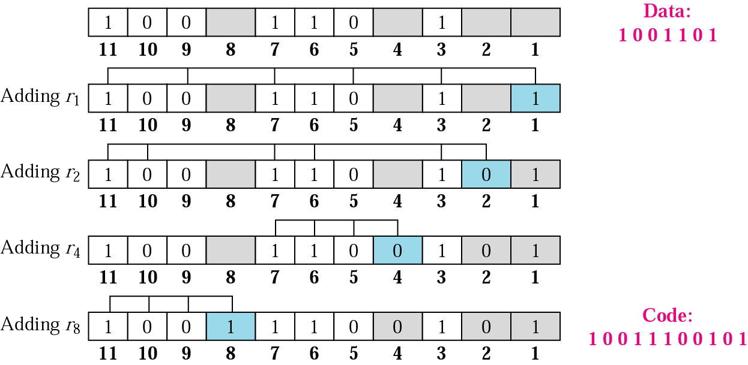
Example of redundancy bit calculation

Slide 34
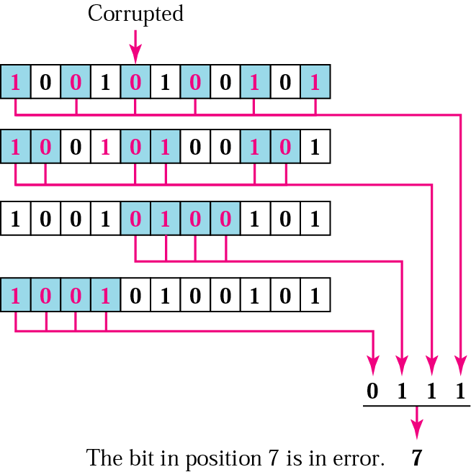
Error detection using Hamming code

Slide 35
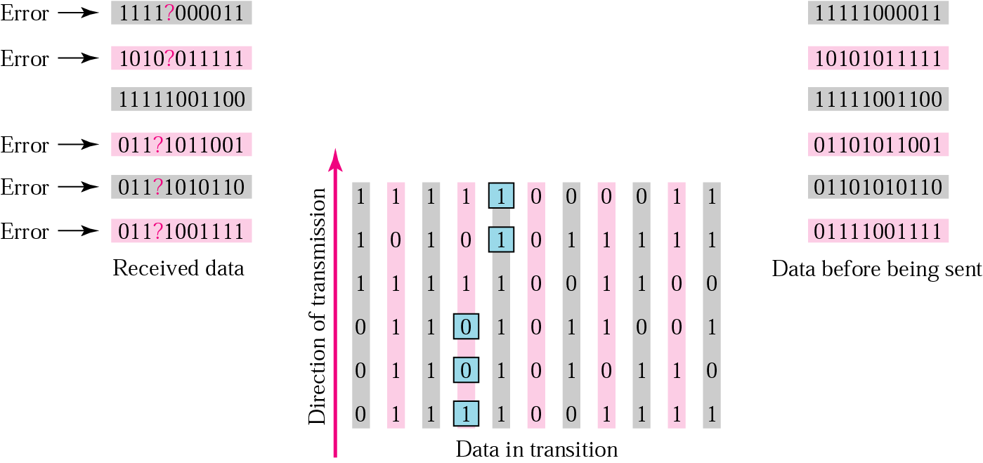
Burst error correction example

